Slide 1
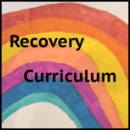
Heading
Recovery Curriculum
A presentation to support school staff with the return of pupils and what to expect
Adapted and based on the research by Barry Carpenter CBE and Matthew Carpenter April 2020
put together by Octavo Educational Psychology Service Croydon
to support our Croydon Community of Schools
May 2020

Slide 2
Key Messages
Importance of relationships and opportunity to reconnect
Take time to understand the needs of your school community (student, parent and staff voice)
Prioritisation of staff well-being
Frame this moment as a learning opportunity to embed wellbeing in the curriculum
Place emphasis on working together, co-operative activities and peer support
Notes:
The purpose of this presentation is to start the conversation about what recovery could look like in your school and should be thought about with the wider staff team over the weeks and months as we adjust to the ‘new normal’.
This is a time to consider what are your school values and how can recovery be led by and reflect this.

Slide 3
The role of school staff when pupils return
Listen to what the students are saying.
Look at what the students are experiencing.
Recognise that a priority is to help children feel they 'belong' somewhere and to connect with their friends
Be their emotionally available adult (trauma informed schools)
Remember every interaction is an intervention (Dr Karen Treisman)
We are social beings and we grow/develop through the interactions that we have with others.

Slide 4
Remember - every person has had a unique experience
Based on:
Differences in level of social interactions and changes to their relationships;
Potential exposure to adverse experiences (bereavement, loss, increased adult anxiety, financial pressures, domestic abuse, isolation etc.);
Differences in resources available (space at home, access to internet and technology, toys);
Variation in home-education experience and learning activities

Slide 5
What will their worries or anxieties be?
RAPID EROSION OF MENTAL HEALTH IN CHILDREN AND YOUNG PEOPLE
Loss of routine
Loss of structure
Loss of friendship
Loss of opportunity
Loss of freedom
ANXIETY
TRAUMA
BEREAVEMENT

Slide 6
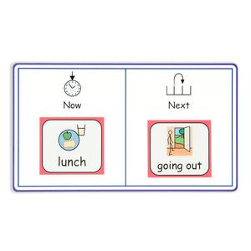
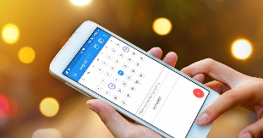
Loss of structure
We all need to know what’s happening NOW and NEXT

Slide 7
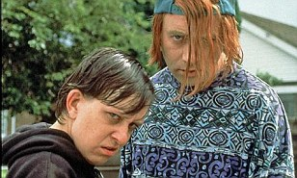
Themes of loss
What teenager wants to be with their parents 24/7? – Come to think of it……
What child, adult, elderly person, pet……?
They have lost their rites of passage – taking exams – SATs, GCSEs, driving test, music or dance performances? I could go on…

Slide 8
“For all of these to appear at once in an untimely and unplanned fashion is significant for a developing child or young person.”
Loss
Anxiety
Bereavement
Trauma

Slide 9
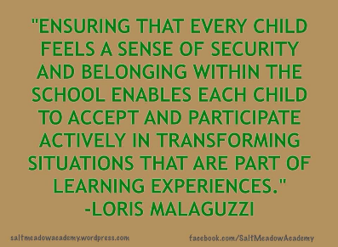
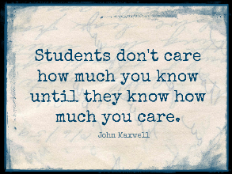
“Our children are vulnerable at this time and their mental health is fragile.”
Does the loss of academic learning really matter in light of the above statement? Our students are experiencing their own anxieties whilst seeing their families, communities, the country and the world in a sea of anxiety. They can’t escape it.

Slide 10
How long will it take for our students to feel NOT threatened by the nearness of others?
There have been increased reports of self-harm – Young Minds 2020
Increased anxiety attacks
Loss of self-control
Is it ok to go out?
How do I know?
Where will I be safe?

Slide 11
anxiety
It’s a cruel companion and eats away at positive mental health and cause deterioration of a young person’s overall well-being.
An anxious child is not a learning child
Loss of sleep diminishes coping mechanisms
We all hear about daily death tolls and people who are facing highly stressful situations.

Slide 12
Key Questions
How do we prepare for going back to school?
What curriculum adjustments need to be made? What is crucial?
How will staff manage their own recovery?
What pedagogical frameworks will facilitate teaching with compassion?
We form a curriculum to recover from loss

Slide 13
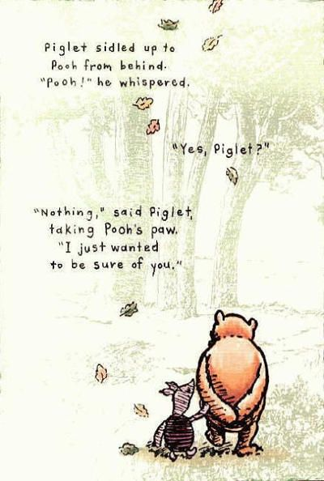
“Teaching is a relationship based profession”
“We all need a holistic recovery; some may need a focussed recovery programme, personalised to their needs; others may need a deeper and longer lasting recovery period, enabling a fuller exploration of the severity of their TRAUMA and emergent ATTACHMENT issues.”
We need to plan for activities that provide the space for recovery.
We need to focus more on FUNDAMENTAL WELLBEING and secure positive development of the young person.

Slide 14
“Three phased curriculum approach”
A three phase approach to the curriculum. Staff will carefully assess individual children and decide the appropriate approach in discussion with their families. At the heart of all three phases is Social, Emotional and Mental health and Wellbeing. Appropriate mental health support and interventions will depend on what phase each individual is at when they return to school.
“
Holistic approach
Focus recovery – personalised needs led approach
Deep recovery – longer period of recovery and specialist support
Notes:
Remembering the professional support services in your local community that may be able to support this.

Slide 15
Levers to help us
Lever 1 – Relationships
Our students won’t all return joyfully. Relationships that were thriving are going to have to be nurtured and restored. We need to PLAN for this to happen. Reach out to the students and greet them – cushion the discomfort of returning.
Lever 2 – Community
Curriculum will have to be based around the community for a long time. We need to listen to what has happened in this time, understand the needs of our community and engage them in the transitioning of learning back into school.
Lever 3 – Transparent curriculum
Students will feel like they have lost time in learning and we must show them how we are addressing these gaps, consulting and co-constructing with our students to heal this sense of loss.

Slide 16
Levers to help us
Lever 4 – Metacognition
In different environments our children will have been learning in different ways. We need to make the skills for learning in a school environment explicit to our students and reskill and rebuild their confidence as learners.
Lever 5 – Space
To be, to rediscover and to find their voice on learning in this issue. We need to make sure this group of learners are not disadvantaged against their peers, providing opportunity and exploration alongside the intensity of our expectations. Teachers need to recognise they have the best intentions to help children 'catch up' but children need space to acclimatise back into school life.

Slide 17
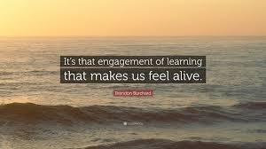
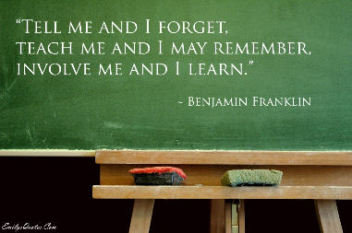
Engagement
Many children will return to school disengaged.
School may seem irrelevant after a long period of isolation.
How will you plan on re engaging your students?
Notes:
Importance here to acknowledge the loss and reassure the community, some schools have been doing this through joint projects.
School staff should be curious about the development and learning experiences that have occurred during lockdown, be this in relationships, in thinking and learning skills etc. Drawing on the transferrable skills e.g. if students have been baking, gardening, gaming etc. These activities require metacognitive skills that can be thought about and celebrated.
Special consideration for groups such as the Y10 cohort who will be sitting exams next year and how best school staff can respond to reduce the anxiety they may be facing or those who may have been school avoiding prior to lockdown who may require more targeted support to re-engage.

Slide 18
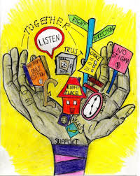
Schools need to show that it is a place where children can feel safe again….
“School is no longer the safe, constant place we thought it was, we must be ready to understand, to re frame their perception and show that we are trustworthy”
Can I trust you again?
Will you abandon me?
Can our lives reconnect?
Can our relationship be re-established?
“Now is the time to get the mental health of our children restored, so that their aspirations for their future, can be a vision that becomes, one day, a reality.”
Notes:
Importance of listening to students and being mindful of the language we use so as to build their self-esteem as they may be feeling doubtful and uncertain.

Slide 19
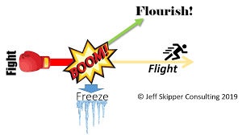
Stress reactions
The children most severely impacted by the pandemic will not find it easy to ‘settle to learn’ (Bomber, 2013) and we must expect their psychological distress to manifest in their behaviour. We know that chronic stress disrupts the nervous system. Many children will be jumpy, volatile, hyper-vigilant; still operating in survival mode and easily triggered into flight or fight reactions. Others may appear dazed or tuned-out. More likely to be girls, these will be the children whose survival strategy is to freeze or to dissociate – to retreat from a frightening and unpredictable outside world into one within the mind that feels more safe.

Slide 20
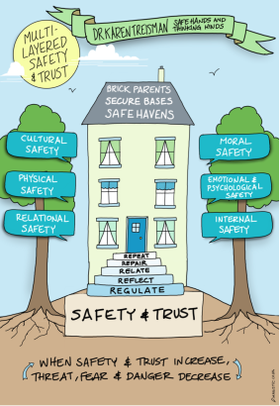
Brick Parent
Never in the history of universal education has there been a more urgent need for our schools to contain and stabilise these children by becoming what Dr Karen Treisman calls the ‘brick parent, the secure base, the safe haven.’ And of course all children will benefit from immersion in the warmth of a relational culture after the deep rupture of Covid-19.

Slide 21
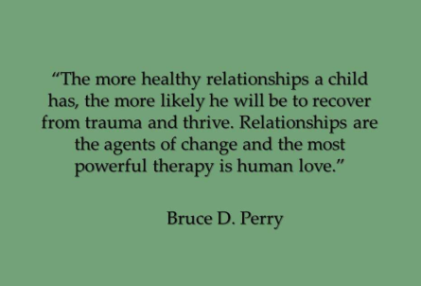
Place relationships front and centre and build social capital
Teachers must be encouraged to be humans first in the wake of this crisis and to build positive relationships, especially with those children who struggle to form social bonds because of their experiences; their lack of trust in adults. These will be the children most in need of what Dr Perry calls ‘social buffering’ and reaching out to them must be a deliberate strategy, not left to chance. In Dr Karen Treisman’s memorable words, ‘Every interaction is an intervention.’

Slide 22
“The good news is that anyone can help with this part of “therapy” – it merely requires being present in social setting and being well, basically, kind….The more we can provide each other these moments of simple, human connection – even a brief nod or moment of eye-contact – the more we’ll be able to help heal those who have suffered traumatic experience”. (From The Boy who was Raised as a Dog)

Slide 23
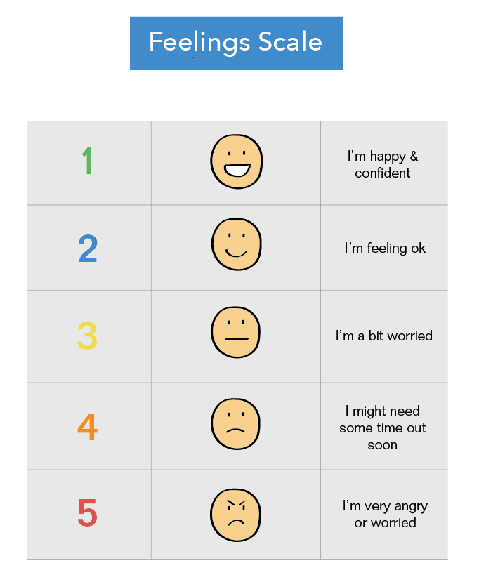
Identify and support children in most need of social buffering
If we value it, we measure it. A simple wellbeing rating scale completed by all pupils – 1 to 5 – and the question, ‘Name an adult in this school who you trust and can talk to’, will suffice. Some children will have expressed their need for additional support through their distressed behaviour. But if we rely on this feedback alone, then we may miss the dissociated children and those hiding through freeze who are equally distressed and in need of intervention.

Slide 24
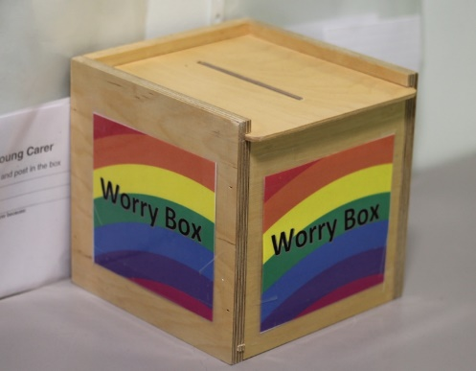
Create a ‘listening’ school
All pupils and families will benefit from being reassured that your school is a listening school. As well as screenings, worry boxes (or inboxes), a morning check-in as part of the daily routine, circles, drop-ins, all of these strategies and more are worth introducing if they are not already available for children and families. The message from school needs to be that we do get this and if you are struggling, we want to know.
The virtual check-ins that have been established with vulnerable families during lockdown should be maintained. Paradoxically, social distancing measures have brought some schools closer to their most vulnerable children and families – a tremendously positive consequence of Covid-19 that mustn’t be jettisoned through a return to business as usual.

Slide 25
Take time to settle
Try and make all expectations clear, but check understanding
Help break tasks down to subtasks and provide supportive and clear feedback during and after each subtask as needed
Scaffold tasks and highlight skills required to achieve learning
Acknowledge successes and provide explicit feedback on what has been achieved.
Believe that the child or young person can achieve academic success
:

Slide 26
Proactive ideas to support wellbeing - primary
Allow children to bring in a familiar and comforting object from home – we call this a ‘transitional object’
Some children may be reassured by speaking with their parent/carer at some point in the day
Expect and plan for some regression in independence skills – this may be a child communicating ‘I need some more nurturing attention’
Create a quiet space for children to retreat to if they are feeling overwhelmed
Plan ‘team building’ type games so children can reconnect with one another
Meet and greet vulnerable children, and allow them some time and space before they are expected to enter the classroom
Spend time ‘checking in’ emotionally with children – you could develop a scale together, of course considering social distancing guidelines

Slide 27
Proactive ideas to support wellbeing - secondary
Gather views from students about how to support the wellbeing agenda
Does your school have a wellbeing ambassador group? This can create a positive understanding and reduce potential stigma of mental health in the wider school. This group could organise events, design art work for the school, share their experiences with others if comfortable. Creating a talking culture.
Safe space provided for those who wish to avail of it with staff to support
Regular check-ins and coaching opportunities provided by staff e.g. https://www.carrmanor.org.uk/coaching/
Use of sporting and enrichment activities, including staff in this, as a way to build relationships and re-connect.
Integrating wellbeing into the curriculum, as well as running workshops for students responding to the needs of the student population e.g. focusing on aspects of their life they gain control of e.g. diet, sleep, when they ask for help, boundaries they set, self-talk
All pupils and families will benefit from being reassured that this is a listening school. As well as screenings, worry boxes (or inboxes), a morning check-in as part of the daily routine, circles, drop-ins, all of these strategies and more are worth introducing if they are not already available for children and families. The message from school needs to be that we do get this and if you are struggling, we want to know.
The virtual check-ins that have been established with vulnerable families during lockdown should be maintained. Paradoxically, social distancing measures have brought some schools closer to their most vulnerable children and families – a tremendously positive consequence of Covid-19 that mustn’t be jettisoned through a return to business as usual.
Notes:
Remember the developmental tasks of adolescence and the importance of peers in their lives, using this resource as a way to support relationships, wellbeing, belonging and meta-cognitive skills.

Slide 28
It’s not all negative!!
Try to remember that there will be a great number of children in your school that will be absolutely fine.
Children are very resilient creatures and there will be many children who have experienced a great deal of positives during Lockdown – it will be important to share and acknowledge these with your children.
All pupils and families will benefit from being reassured that this is a listening school. As well as screenings, worry boxes (or inboxes), a morning check-in as part of the daily routine, circles, drop-ins, all of these strategies and more are worth introducing if they are not already available for children and families. The message from school needs to be that we do get this and if you are struggling, we want to know.
The virtual check-ins that have been established with vulnerable families during lockdown should be maintained. Paradoxically, social distancing measures have brought some schools closer to their most vulnerable children and families – a tremendously positive consequence of Covid-19 that mustn’t be jettisoned through a return to business as usual.

Slide 29
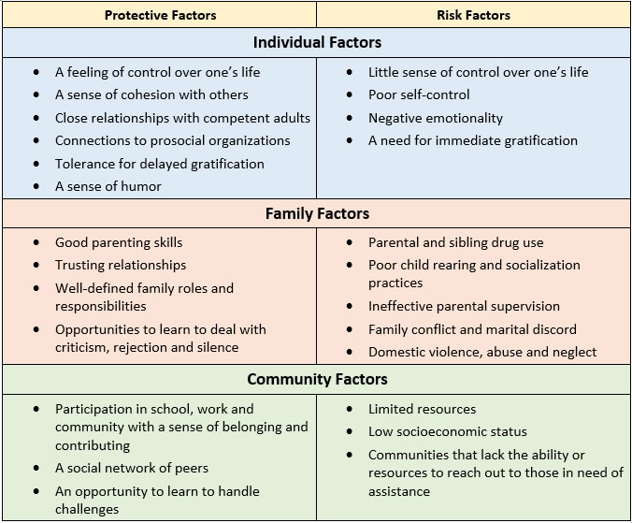
What helps children become resilient?
School staff can promote children’s resilience in these areas
All pupils and families will benefit from being reassured that this is a listening school. As well as screenings, worry boxes (or inboxes), a morning check-in as part of the daily routine, circles, drop-ins, all of these strategies and more are worth introducing if they are not already available for children and families. The message from school needs to be that we do get this and if you are struggling, we want to know.
The virtual check-ins that have been established with vulnerable families during lockdown should be maintained. Paradoxically, social distancing measures have brought some schools closer to their most vulnerable children and families – a tremendously positive consequence of Covid-19 that mustn’t be jettisoned through a return to business as usual.

Slide 30
Next Steps
Consider as a staff group how you move forward:
Holding on to the values of recovery and integrating these into the national curriculum.
Holding back on formal assessment, allowing time for recovery of skills
Holding in mind the most vulnerable groups
Together as the great team you are!

Slide 31
References
Direct quotes are taken from the Barry Carpenter Recovery Curriculum text, the first podcast was produced on 29/4/2020 – check on the website for podcast updates: https://www.evidenceforlearning.net/recoverycurriculum/
The Boy Who Was Raised as a Dog, 3rd Edition: And Other Stories from a Child Psychiatrist's Notebook--What Traumatized Children Can Teach Us About Loss, Love, and Healing; Bruce D. Perry, Maia Szalavitz
Dr Karen Treisman; “Working with children and adolescents who have experienced relational and developmental trauma” (Routledge, 2016)
Five ways to help schools heal when they re open Mary Meredith April 2020 https://marymered.wordpress.com/2020/04/14/five-ways-to-help-children-heal-when-schools-reopen/
Inside I'm Hurting: Practical Strategies for Supporting Children with Attachment; Louise Michelle Bombèr

Slide 32
Resources
For Children and Adolescents
“Five Ways to Help Children Heal When Schools Reopen”
https://marymered.wordpress.com/2020/04/14/five-ways-to-help-children-heal-when-schools-reopen/
“It’s OK to not be OK right now and to just do your best to get through this truly unprecedented time.”
https://www.usatoday.com/story/life/health-wellness/2020/04/13/coronavirus-quarantine-why-you-dont-have-productive-right-now/2960296001/?fbclid=IwAR2bAU37kXk9wng2dCmeBTrXagkbk8HY0DbtQn7Qba0Vna5Urk00OqGsSjg
“Talking to Children About COVID-19”
https://www.aacap.org/App_Themes/AACAP/Docs/latest_news/2020/Coronavirus_COVID19__Children.pdf
“With Senior Year in Disarray, Teens and Young Adults Feel Lost. Here’s How to Help”
https://www.npr.org/sections/health-shots/2020/04/19/837077850/with-senior-year-in-disarray-teens-and-young-adults-feel-lost-heres-how-to-help?fbclid=IwAR1RAXCtzOCT1q1kMhhMCubwgftXK11FeJhKFusbEQmtDEBdSmWC-BvH5s0
“Why It’s So Hard to Talk to Your Parents About the Coronavirus (and Vice Versa)”
https://www.wsj.com/articles/why-its-so-hard-to-talk-to-your-parents-about-the-coronavirus-and-vice-versa-11587236112

Slide 33
Resources
For school staff
https://www.mentallyhealthyschools.org.uk/resources/
https://www.annafreud.org/coronavirus-support/
https://us4.campaign-archive.com/?u=3d62186a3cccbe2cd207b7b0f&id=86e5526edc
https://www.restorativecommunityconcepts.com/uploads/2/8/1/0/2810779/responding_to_the_needs_of_children_in_crisis_rcc.pdf
http://www.safehandsthinkingminds.co.uk/about-us/

